Slide 1
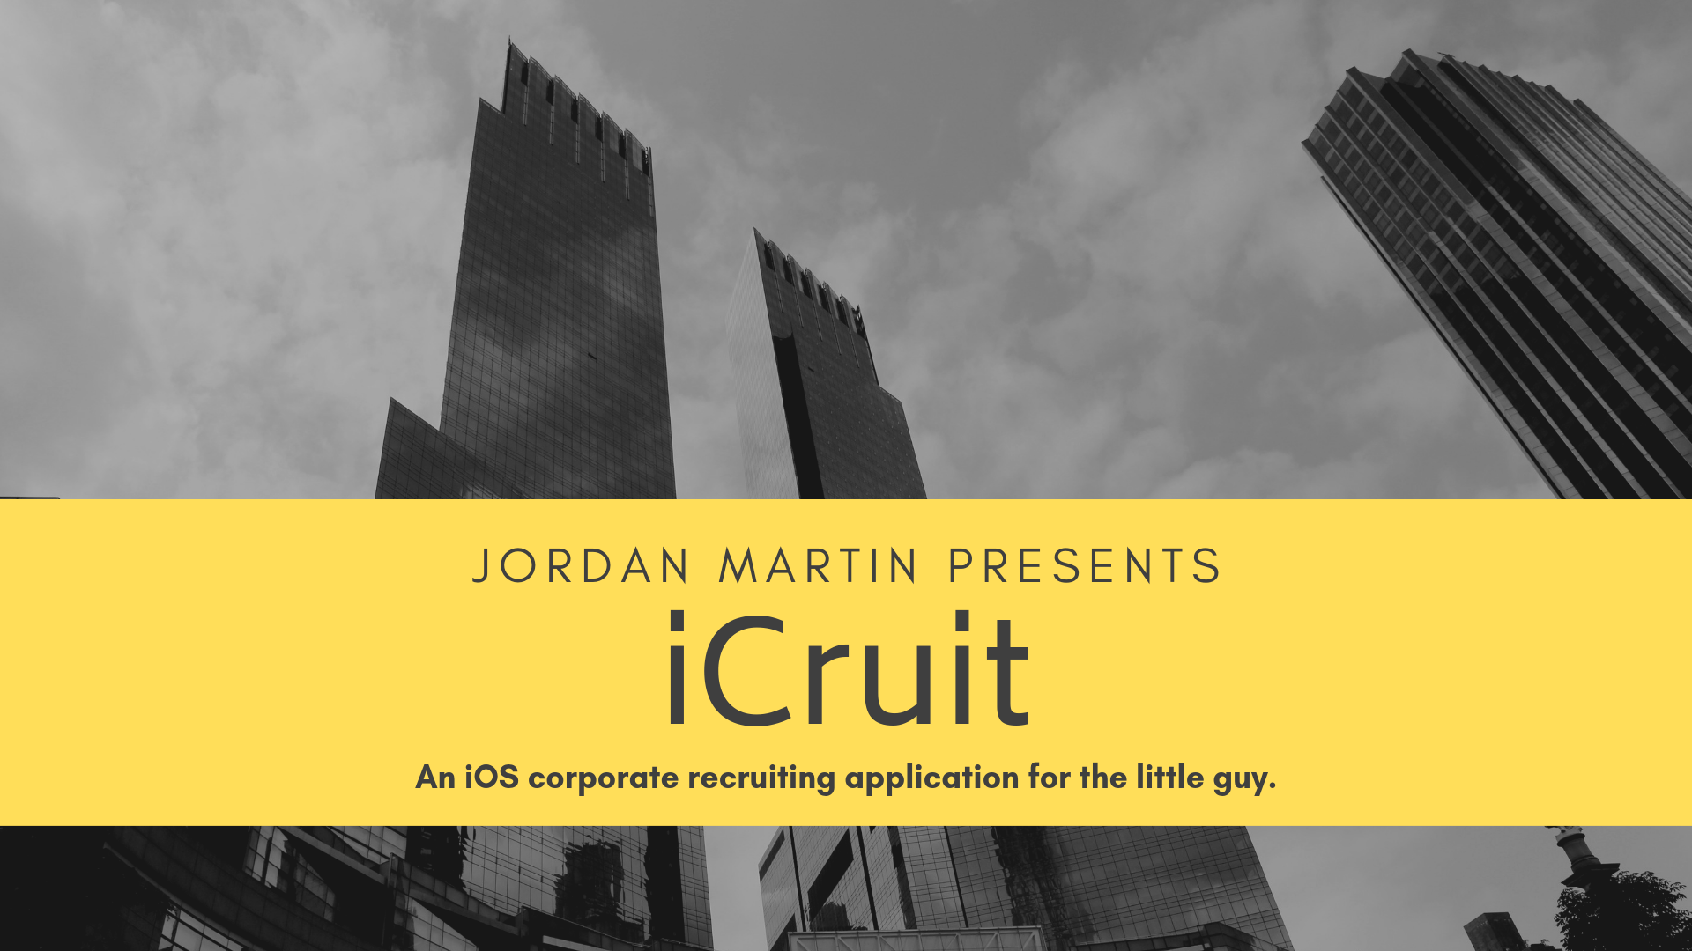

Slide 2
Goals
Issue:
Small companies want to gather information about potential candidates, but don’t want to pay a company to design a customized app for them
Outcome:
An application that companies can bring to career fairs and other events to gather information about potential candidates and export the data for analysis by recruiters and other HR professionals
Future:
Add feature to scan resumés and store pdf files with the other data
Submit the app to the Apple App Store

Slide 3
Features
Recruiters can customize all of the questions, company name and the main color using password protected menus
Recruiters can also view the submissions in a similar menu
App will not require Wi-Fi to work as many career fairs have no or spotty Wi-Fi
Data can be exported as CSV files via email when the iPad is connected to Wi-Fi

Slide 4

Resources/Technologies

Slide 5
Design Pattern
I used a loose version of the MVC design pattern.
The model is all in the UserDefaults of the application allowing data to persist between between uses of the app
The view is a couple UITableViews with custom prototype cells that are created in custom classes and then added by the controller
The controllers dictate what happens when the user taps cells of different types and manipulates the data based on user input

Slide 6
Agile Methodology
I created various user stories in a word document and slowly knocked them off during the semester.
The user stories were as follows:
Learn Swift through online tutorials
Build Hello World app
Add two slide out menus
Add each feature individually:
Edit Color
Edit Company Name
Present Questions
Edit Questions
Perform UI tests
Lock/Unlock
Reset App
View Responses
Tutorial

Slide 7
Hurdles
I had never previously utilized Swift for iOS development and that proved harder than I thought to learn. After implementing the original menus, I felt better.
Building an app from scratch has also proven to be more difficult than I expected. I had no experience editing the storyboard which I have found to be incredibly difficult.
Acting as both the product owner and developer causes me to get lost in the big picture as well as the smaller details.
I wasn’t on a regular schedule at the beginning of the semester, but over the last few weeks, I have devoted all of my free time to the project.

Slide 8

Project Timeline
October 1st
Create basic “Hello World” app that contains all views and set up GitHub repository
December 1st
Create minimally viable application
December 8th
Make design look more professional
December 13th
Finish application and perform UI tests
December 14th
Upload all artifacts to Canvas and present
November 1st
Learn Swift to a point that I'm comfortable

Slide 9
Demo / UI Tour
I will now go through a demo that shows all of the UI and features of iCruit.

Slide 10
Future Work
I’ve decided to continue working on this project during my free time as a hobby project to enhance my mobile development skills
My next goal is to rewrite the application from the ground up utilizing test-driven development TDD, as all of my testing so far has just been UI testing rather than unit testing
After that, I’d like to add PDF functionality
Finally, I would like to get it approved for the Apple App Store and charge $1.99 per download
Someday, I’d like to make a companion Android application

Slide 11
My Future
Graduating in May 2019 with Computer Science and Mathematics majors as well as Leadership Studies and Business Administration minors
I will be starting full-time as an IT EDP at John Deere in June
I will be moving to either Des Moines, IA, Madison, WI or Cary, NC with my girlfriend, Amy who is also graduating in May 2019

Slide 12
Questions?

